Slide 1
White Box Clustering in R

Slide 2

HELLO!
Sandro Radovanović
You can find me at
sandro.radovanovic@gmail.com

Slide 3
1. Clustering
Brief Introduction

Slide 4
Clustering
“…is the task of grouping a set of objects in such a way that objects in the same group (called a cluster) are more similar (in some sense) to each other than to those in other groups (clusters).”
Wikipedia

Slide 5
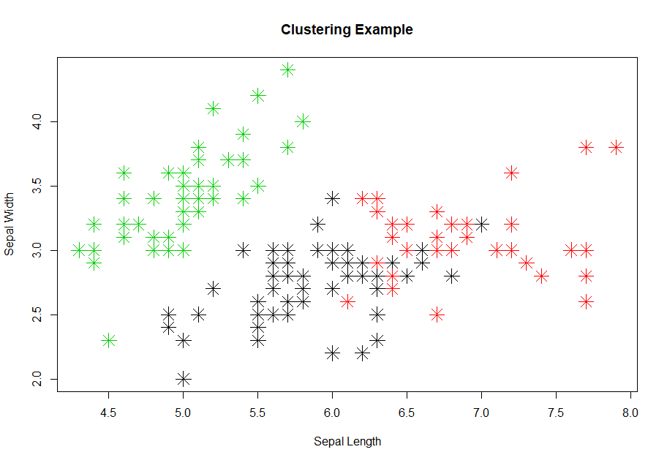
Clustering
Distance between data points in cluster is minimized
Distance between clusters is maximized

Slide 6
Clustering
How do you define “similarity”?
What is good clustering (quality of clustering)?
Are those groups informative?

Slide 7
Applications of Clustering
Production
Sizes of shirts
Marketing
Segmentation of customers
Bio-informatics
Gene expression Clustering

Slide 8
2. Representative based Clustering

Slide 9
Clustering Algorithms
Representative based
Density based
Hierarchical based
Bi-clustering (Co-clustering)
Etc.

Slide 10
Why Representative based
“K-means is by far the most popular clustering algorithm used in scientific and industrial applications” – Berkin (2006)
Top 10 algorithms in Data Mining (Wu et al., 2008)

Slide 11
Pros of Representative based Clustering
Easy to use
Intuitive
Understandable results
Speed

Slide 12
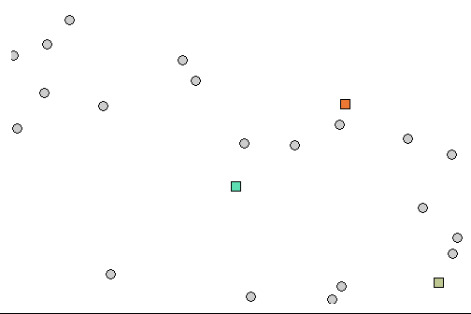
Representative based Clustering

Slide 13
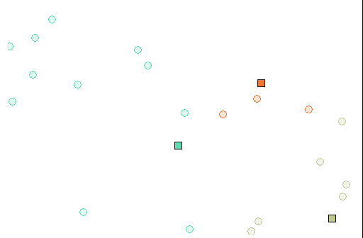
Representative based Clustering

Slide 14
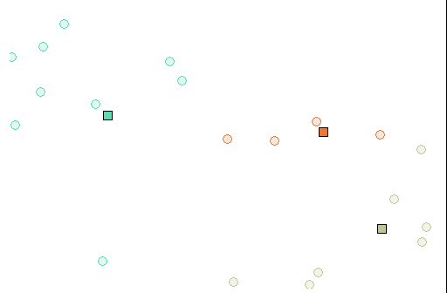
Representative based Clustering

Slide 15

Representative based Clustering

Slide 16
Steps of algorithm
Initialize Representatives (Centroids)
Calculate distance to Representatives
Assign to Representatives
Update Representatives

Slide 17
Cons of Representative based Clustering
Quality depends of initial Representatives
Outliers
Different distance measures

Slide 18
History of Representative based Clustering
K-means (Hartigan et al., 1979)
K-means++ (Arthur et al., 2007)
K-medoids (Kaufman & Rousseeuw, 1990)
X-means (Pelleg & Moore, 2000)
MPCK-means (Basu et al., 2004)
Etc.

Slide 19
3. White Box Design

Slide 20
Black-Box Algorithm Design
Implementation is kept away from user.
Different implementation of same algorithm.
(Already implemented) Components are re-implemented.
Weaker understanding of the algorithm.

Slide 21
White-Box Algorithm Design
Using “good parts” of the algorithm.
Faster building of new algorithms.
Potential for more detailed comparison.
Better understanding of the algorithm.

Slide 22
Whibo Clustering – Generic algorithm
Define number of clusters
Initialize representatives
Measure distance
(Assign)
Update representatives
Stop Criteria
Delibašić B, Kirchner K, Ruhland J, Jovanović M, Vukićević M (2009) Reusable components for partitioning clustering algorithms, Artificial Intelligence Review, 32(1-4), p. 59-75

Slide 23
WhiBo Clustering - Components
(Optional) Normalize
Initialize
Measure Distance (Assign to Cluster)
Update Representatives
Stop Criteria

Slide 24
WhiBo Clustering - Components
Z Transformation
L2 Normalization
L1 Normalization
Linf Normalization
Max-Min Normalization
Mean Normalization
Logarithmic Normalization
Non-monotonic Normalization
Comprehensive Normalization
Decimal Scaling
Sigmoid Scaling
Softmax Scaling
(Optional) Normalize
Initialize
Measure Distance (Assign to Cluster)
Update Representatives
Stop Criteria

Slide 25
WhiBo Clustering - Components
Random
Forgy
K-Means ++
KKZ
PCA
AGNES
DIANA
Ward
Quantile
CCIA
(Optional) Normalize
Initialize
Measure Distance (Assign to Cluster)
Update Representatives
Stop Criteria

Slide 26
WhiBo Clustering - Components
Euclidean (and Squared Euclidean)
Manhattan
Canberra
Chebyshev
Cosine
Correlation
Sorensen
Ruzicka
Tanimoto
Jaccard
Dice
Bhattacharyya
Hellinger
Whittaker
And others…
(Optional) Normalize
Initialize
Measure Distance (Assign to Cluster)
Update Representatives
Stop Criteria

Slide 27
WhiBo Clustering - Components
Mean
Median
Trimmed Mean
Geometric Mean
Harmonic Mean
Trimean
Midhinge
Midrange
Online versions
And others…
(Optional) Normalize
Initialize
Measure Distance (Assign to Cluster)
Update Representatives
Stop Criteria

Slide 28
WhiBo Clustering - Components
(Optional) Normalize
Initialize
Measure Distance (Assign to Cluster)
Update Representatives
Stop Criteria
Maximum iterations
No changes

Slide 29
56,100
In total one can create a total of (clustering experiments):
And this number can (and will be) extended…

Slide 30
Demo

Slide 31
4. Future Work

Slide 32
Future Work
Publish to CRAN ☺
Add more components!!
Create White Box Decision Tree Algorithm.

Slide 33




Special Thanks to other Team Members
Prof. dr Milija Suknović
Prof. dr Boris Delibašić
Prof. dr Milan Vukićević
Prof. dr Miloš Jovanović

Slide 34
THANKS!
Any questions?
You can find me at:
sandro.radovanovic@gmail.com

